Slide 1


SMART ICU PATIENT MONITORING SYSTEM USING COMPUTER VISION AND DEEP LEARNING
SIMATS ENGINEERING
Saveetha Institute of Medical and Technical Sciences
Chennai-602105
  ITA0517 – COMPUTER VISION
Supervised By:
Dr S CHRISTY
Presented By:
RAJA RAJESHWARI M -192421253 YOGA MADHA A-192425058

Slide 2

INTRODUCTION
AI-based system for real-time ICU patient monitoring.
Uses Computer Vision and Deep Learning to analyze patient video.
OpenCV processes the camera feed.
YOLO detects the patient and ICU bed.
MediaPipe analyzes body posture and movement.
Detects important events and provides real-time alerts.
Firebase is used to store event details and screenshots.

Slide 3

PROBLEM STATEMENT
ICU patients require continuous observation.
Healthcare staff cannot monitor every patient at every moment.
Patient falls and bed-exit attempts may happen unexpectedly.
Manual monitoring increases the workload of medical staff.
Normal CCTV only records video and does not automatically analyze patient activities.
Therefore, an automated Computer Vision system is needed to identify critical events quickly.

Slide 4

OBJECTIVES
Develop an AI-based ICU patient monitoring system using Computer Vision.
Detect patients and ICU beds using YOLO.
Monitor bed occupancy and patient movement.
Analyze patient posture using MediaPipe.
Detect potentially critical events such as falls and bed-exit attempts.
Generate real-time alerts for critical situations.
Store patient events and screenshots securely using Firebase.
Provide a simple web dashboard for healthcare staff.

Slide 5
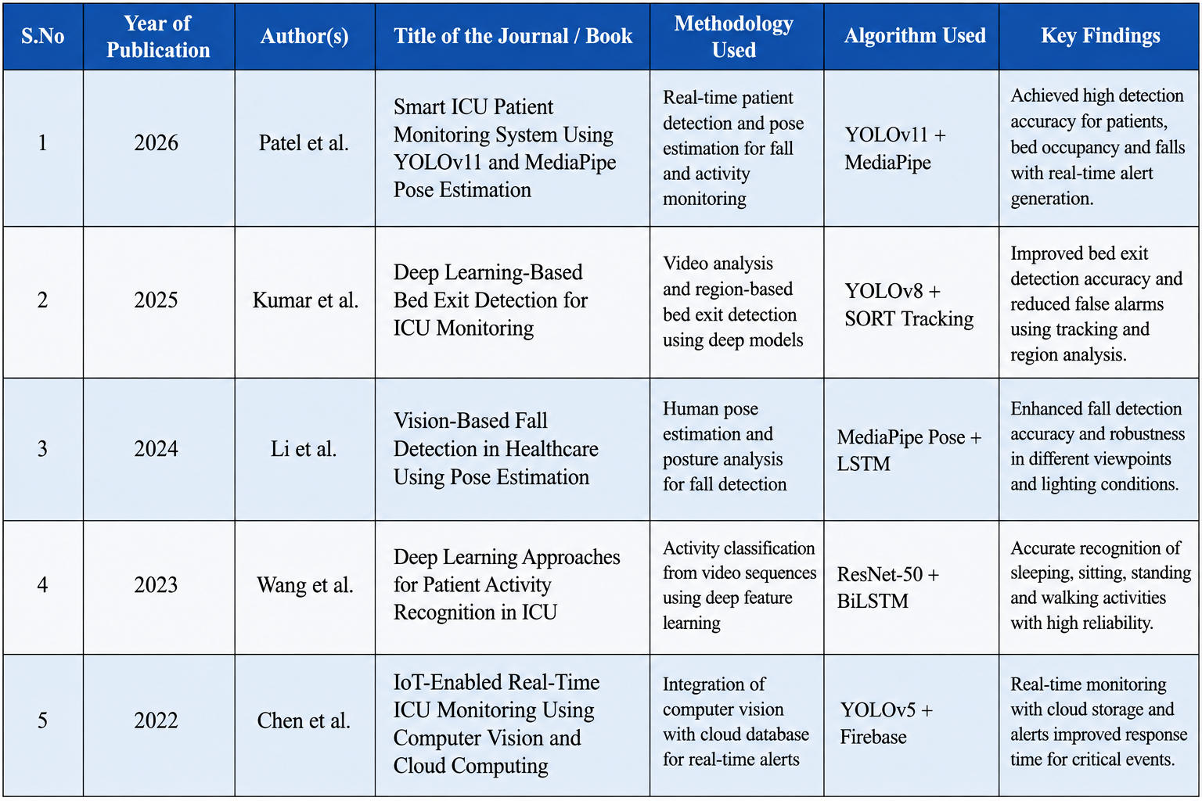
LITERATURE REVIEW

Slide 6
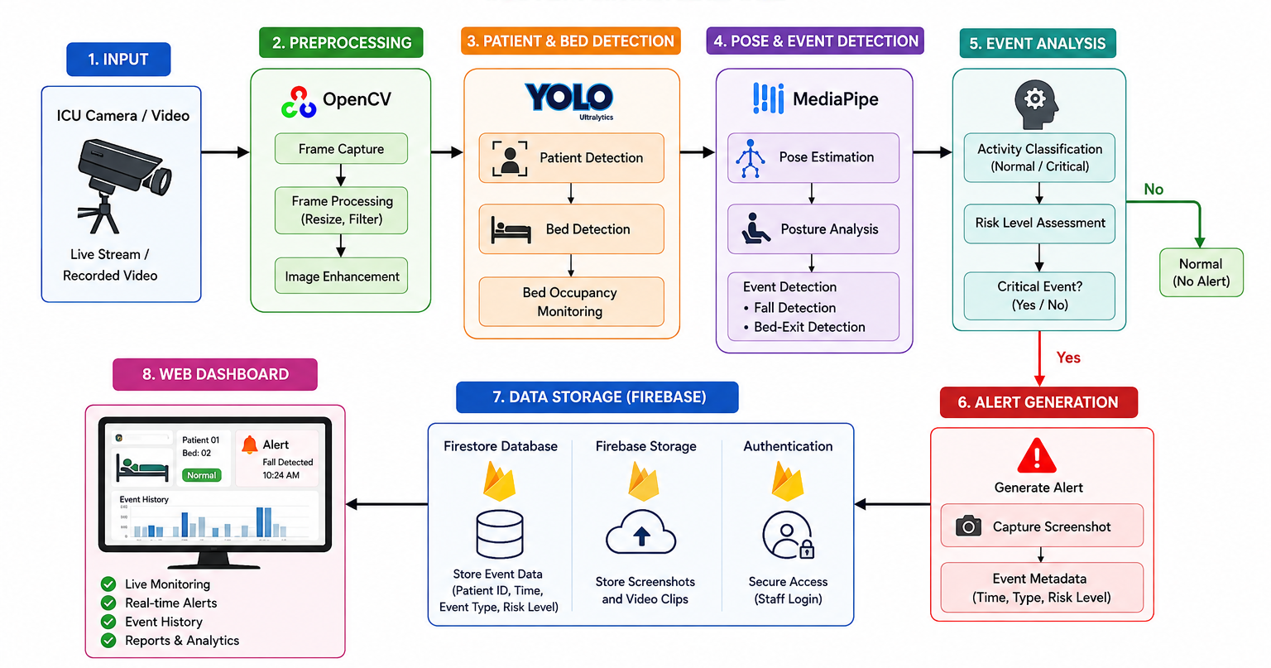
SYSTEM ARCHITECTURE

Slide 7

Module 1 – ICU Dashboard & Patient Management
Secure role-based login for Doctor, Nurse, and Admin.
ICU dashboard showing current patients, occupied beds, available beds, and alerts.
Patient management with patient status and monitoring information.
Live camera interface for real-time ICU video monitoring.
Bed occupancy monitoring to identify occupied and available beds.
Patient activity overview for quick monitoring of ICU activities.

Slide 8
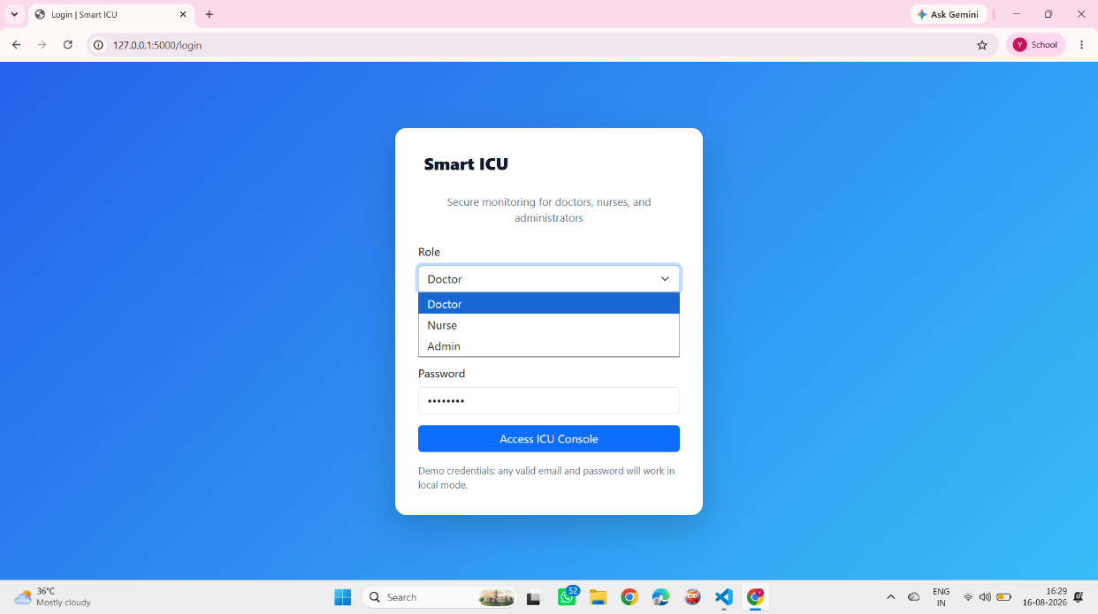
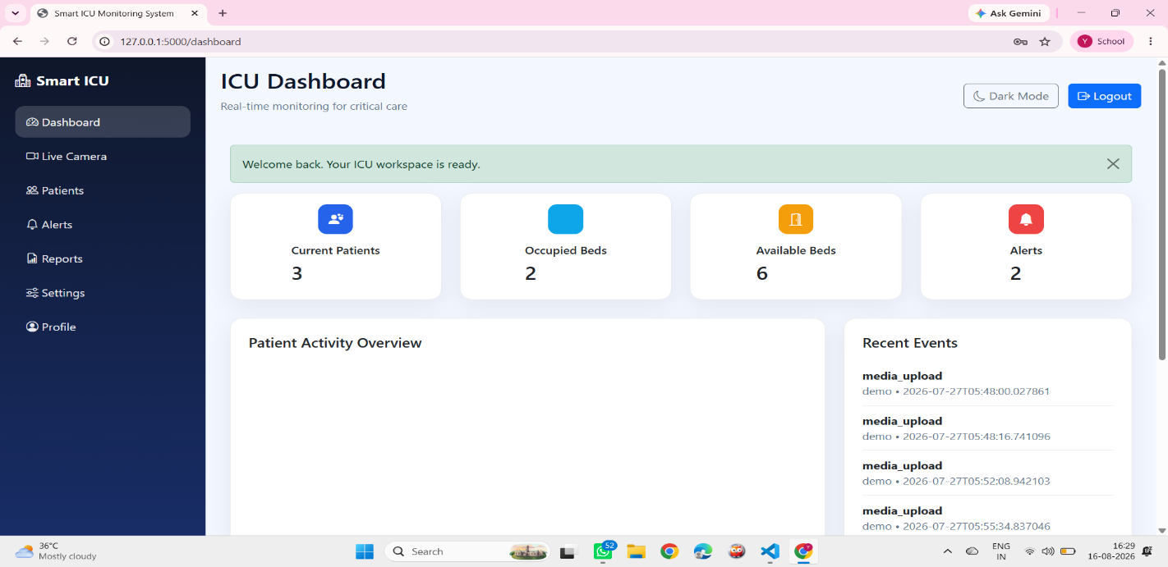
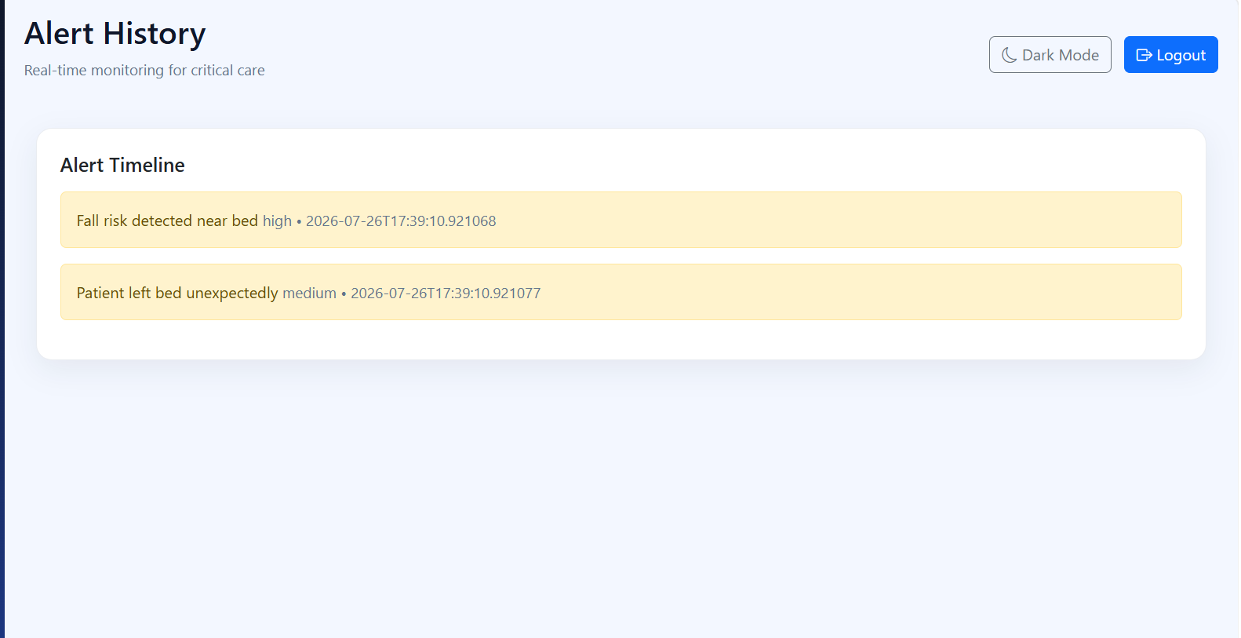
IMPLEMENTATION

Slide 9

Module 2 – AI Computer Vision & Alert Detection
YOLO-based object detection for patients, beds, and relevant ICU objects.
MediaPipe-based pose estimation for analyzing patient posture and movement.
Patient activity detection from live or uploaded video.
Fall-risk and bed-exit detection for identifying potentially dangerous situations.
Patient status classification into normal, warning, or critical conditions.
Real-time critical alerts when abnormal events are detected.

Slide 10
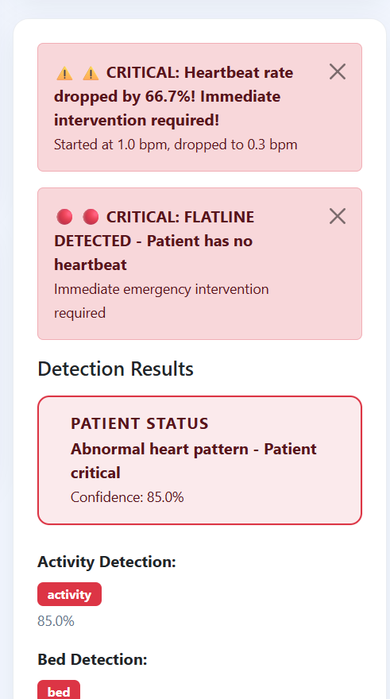
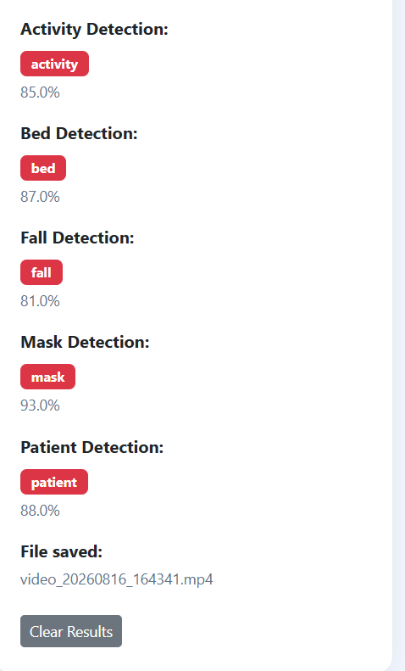
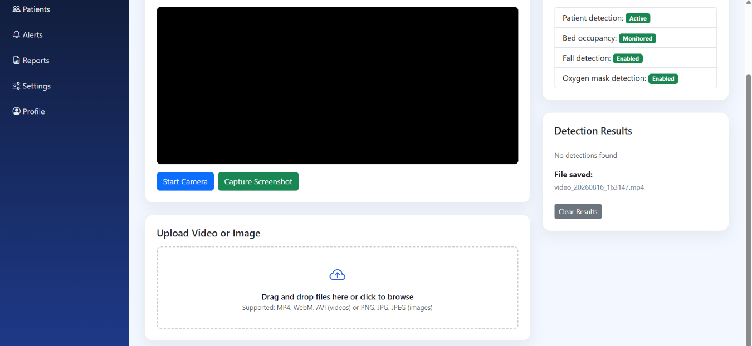
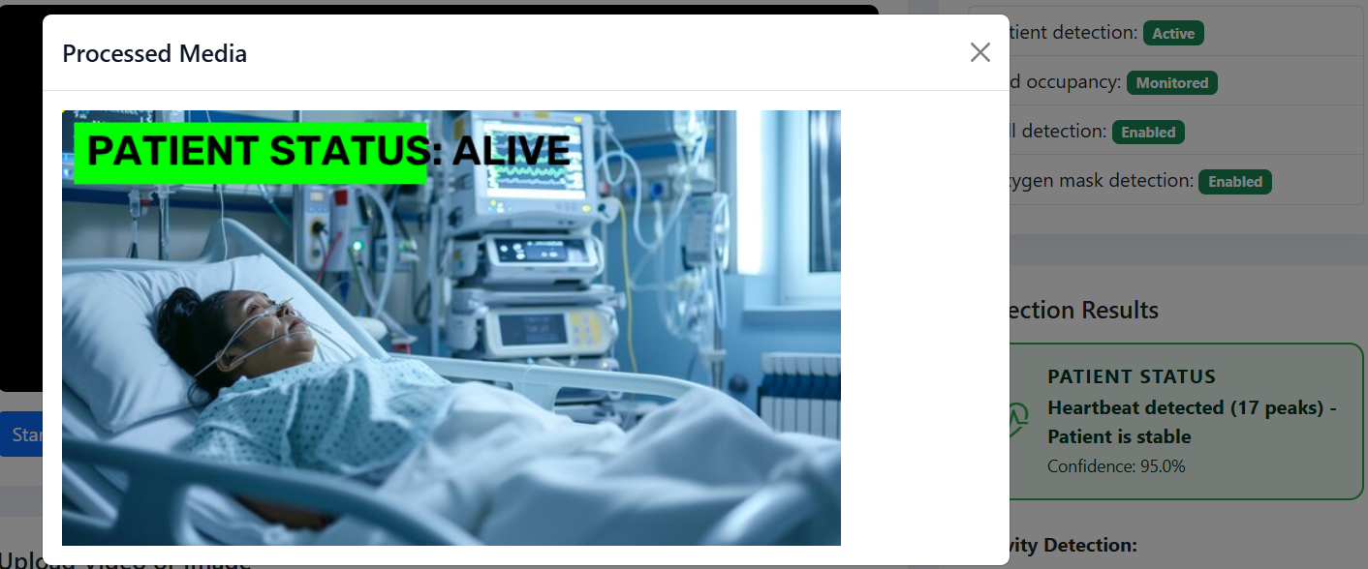
IMPLEMENTATION

Slide 11
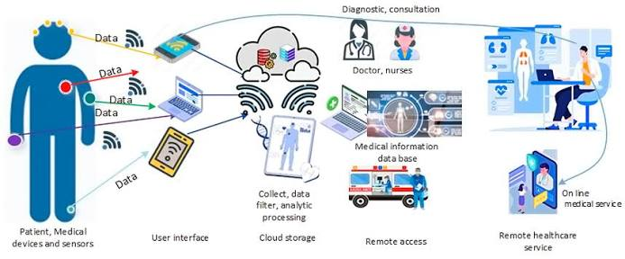
Future Scope
Multiple ICU Cameras – Monitor multiple patients and beds simultaneously.
Mobile Alerts – Send instant emergency notifications to doctors and nurses.
Vital Sign Integration – Connect IoT sensors for heart rate, SpO₂, and temperature.
Advanced AI Prediction – Predict falls and critical patient conditions earlier.
Improved Accuracy – Handle different lighting, camera angles, and patient positions.
Secure Healthcare Deployment – Strengthen patient-data privacy and cloud security.

Slide 12
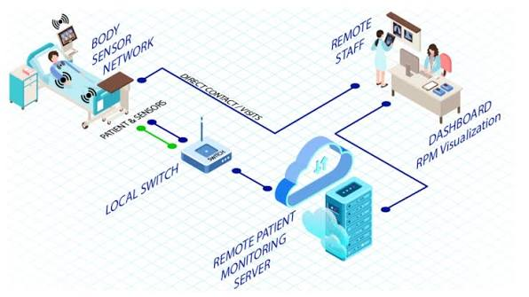
CONCULSION
Captures live video using a camera.
Uses OpenCV for video and frame processing.
Uses YOLO to detect the patient and ICU bed.
Identifies whether the bed is occupied or empty.
Provides patient location and detection confidence.
Sends the detection information to the event analysis module.

Slide 13
REFERENCES
Redmon, J., Divvala, S., Girshick, R., & Farhadi, A. (2016). You Only Look Once: Unified, real-time object detection. Proceedings of the IEEE Conference on Computer Vision and Pattern Recognition (CVPR), 779–788. https://doi.org/10.1109/CVPR.2016.91
Jocher, G., Chaurasia, A., Qiu, J., & Ultralytics. (2023). YOLO by Ultralytics. Ultralytics Documentation. https://docs.ultralytics.com
Lugaresi, C., Tang, J., Nash, H., McClanahan, P., Uboweja, E., Hays, M., Zhang, F., Chang, C.-L., Yong, M. G., Lee, J., Chang, W.-T., Hua, W., Georg, M., & Grundmann, M. (2019). MediaPipe: A framework for building perception pipelines. arXiv preprint arXiv:1906.08172. https://doi.org/10.48550/arXiv.1906.08172
Bradski, G. (2000). The OpenCV Library. Dr. Dobb’s Journal of Software Tools, 25(11), 120–125.
Zhang, X., Tao, X., & Wang, J. (2022). A review of vision-based human fall detection methods. Sensors, 22(21), 8273. https://doi.org/10.3390/s22218273

Slide 14


